Slide 1
Python – Modules and Packages Manikandan R.

Slide 2
Agenda
Introduction to Modules and Packages
Using Import Statement
Using if __name__ == "__main__"
Package Initialization
Assignment

Slide 3
Introduction to Modules and Packages
Modules:
What is module? - A python file containing definitions and statements. A module can define functions, classes and variables.
Why it is better option to use modules? – Minimization of dependencies is the goal. When we build a large application, dividing tasks into minimal is becoming mandatory for manageability.
Packages:
What is Package? - Packages are namespaces which contain multiple packages and modules themselves. E.g - Directory with multiple sub-directory.
Why Packages are required ? – Assume you have developed a very large application that includes many modules. As the number of modules grows, it becomes difficult to keep track of them all if they are dumped into one location. Packages allow for a hierarchical structuring of the module namespace using dot notation.
Arrays of object references

Slide 4
Using import statement
└── project
├── package1
│ ├── module1.py
│ └── module2.py
└── package2
├── __init__.py
├── module3.py
├── module4.py
└── subpackage1
└── module5.py
from package1 import module1
from package1.module2 import function1
from package2 import class1
from package2.subpackage1.module5 import function2
Arrays of object references

Slide 5

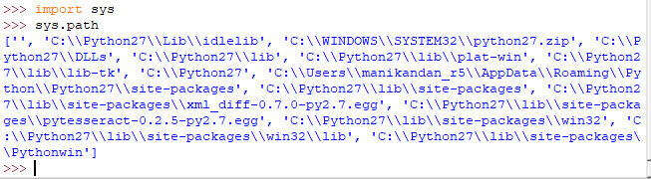


Importing custom modules..
Assume you have created a module.py with execute_cmd function.
Arrays of object references

Slide 6
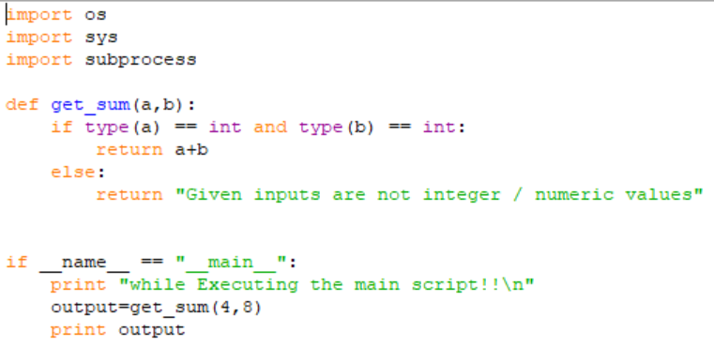
Using if __name__ == "__main__"
When Python interpreter reads a source file, it will execute all the code found in it.
When Python runs the "source file" as the main program, it sets the special variable (__name__) to have a value ("__main__").
When you execute the main function, it will then read the "if" statement and checks whether __name__ does equal to __main__.
In Python "if__name__== "__main__" allows you to run the Python files either as reusable modules or standalone programs
Arrays of object references

Slide 7
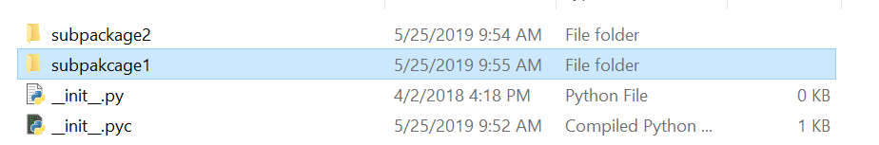
Package Initialization
There should be a __init__.py file(usually kept empty) in a directory. When a python scripts need to look down into the hierarchical level, the existance of __init__.py file will lead the program flow. Otherwise “package not found error” occurs.
Arrays of object references

Slide 8
Assignment -1
Create a package with multiple modules to download a file and verify hash value of a file.
Create a module with string operations and another module with calculator operations and create a package out of these and try to import the package and the module properties accordingly.
Try to reach the package file with and without __init__.py in the module package folders

Slide 9
Thank you

